Slide 1
Project Presentation with TWINMOTION
ORB University
Vol. 1: INTRODUCTION
Vol. 2: RENDERING CREATION
Presented by:
Gabriela Nessi, Jhon Heredia, Miguel Terán.

Slide 2
Vol. 1: INTRODUCTION
CONTENT:
INTRODUCTION – What it is? How it Works? Why it works?
ORB INTENT – Add Service for our clients.
RENDERINGS FROM REVIT FOR CLIENT APPROVAL.
SOFTWARE REQUIRMENTS AND INSTALLATION PROCESS – Twinmotion and Datasmith
REVIT SETTINGS FOR RENDERING PROCESS
TWINMOTION INTERFACE

Slide 3
Vol. 2: RENDERING
CONTENT:
ORB PRESET FILE
MODEL IMPORT
PICTURE FRAMING
EXTERIOR LIGHTING/ INTERIOR LIGHTING
ASSIGN MATERIALS
IMPORT AND PLACE OBJECTS
RENDERING PRODUCTION EXPORT

Slide 4
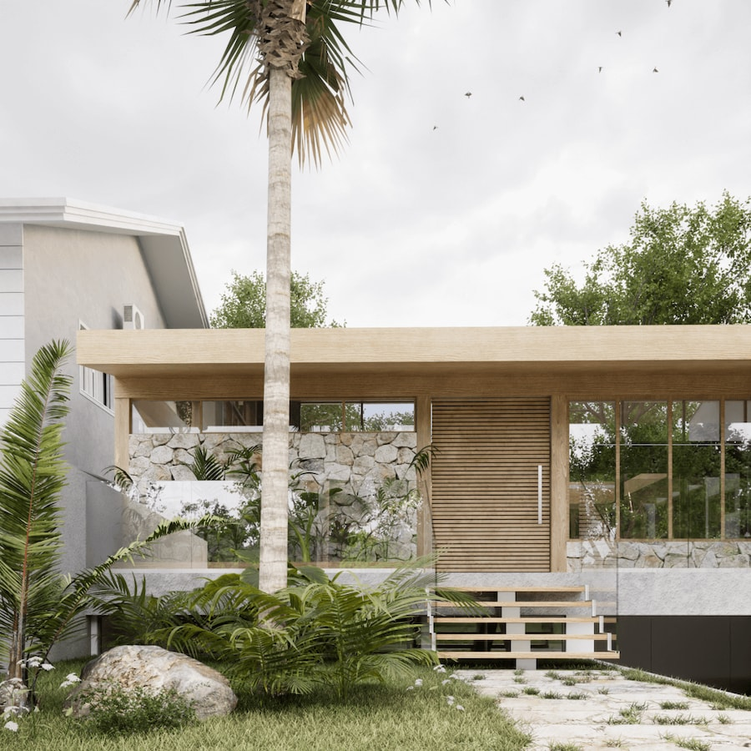
What is Twinmotion?
3D REAL-TIME VISUALIZATION SOFTWARE
https://www.twinmotion.com/en-US/solutions/architecture

Slide 5
How it works?
3D MODEL IN REVIT
EXPORT OR LINK MODEL TO TWINMOTION
SET CAMERA SETTINGS (PERSPECTIVE VIEW)
SETTING LIGHTHING, TEXTURES, MATERIALS
ENVIROMENT (TREES, OBJETCTS, CHARACTERS, ETC.)
POSTPRODUCTION

Slide 6
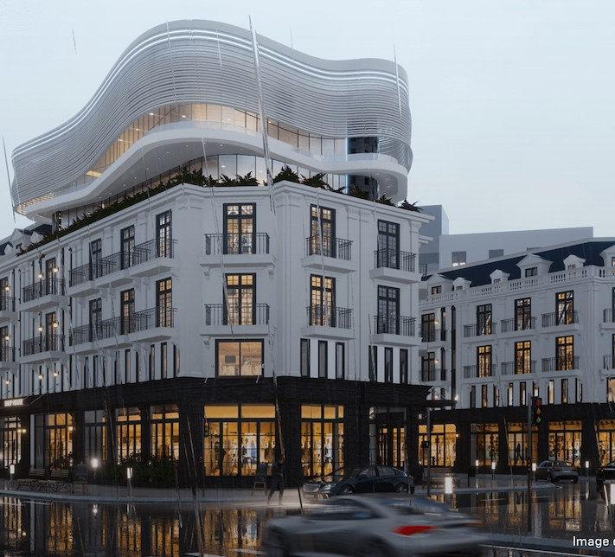
Why Twinmotion?
COMPATIBILITY WITH BIM
CONNECTS DIRECTLY TO REVIT WITH A ‘DIRECT LINK’
REVIT EXPORTS VIA ‘DATASMITH’
HIGH QUALITY
RENDERS, PANORAMA VIEWS, VR AND PRESENTATIONS
LIBRARY INCLUDED
USER-FRIENDLY INTERFACE
FREE EDUCATIONAL CONTENT AVAILABLE ONLINE
No extra cost! – INCLUDED IN OUR BIM LICENSE

Slide 7
PRELIMINARY RENDERINGS FROM REVIT FOR CLIENT APPROVAL.
All visualization work starts from the focus on the project milestone.

Slide 8
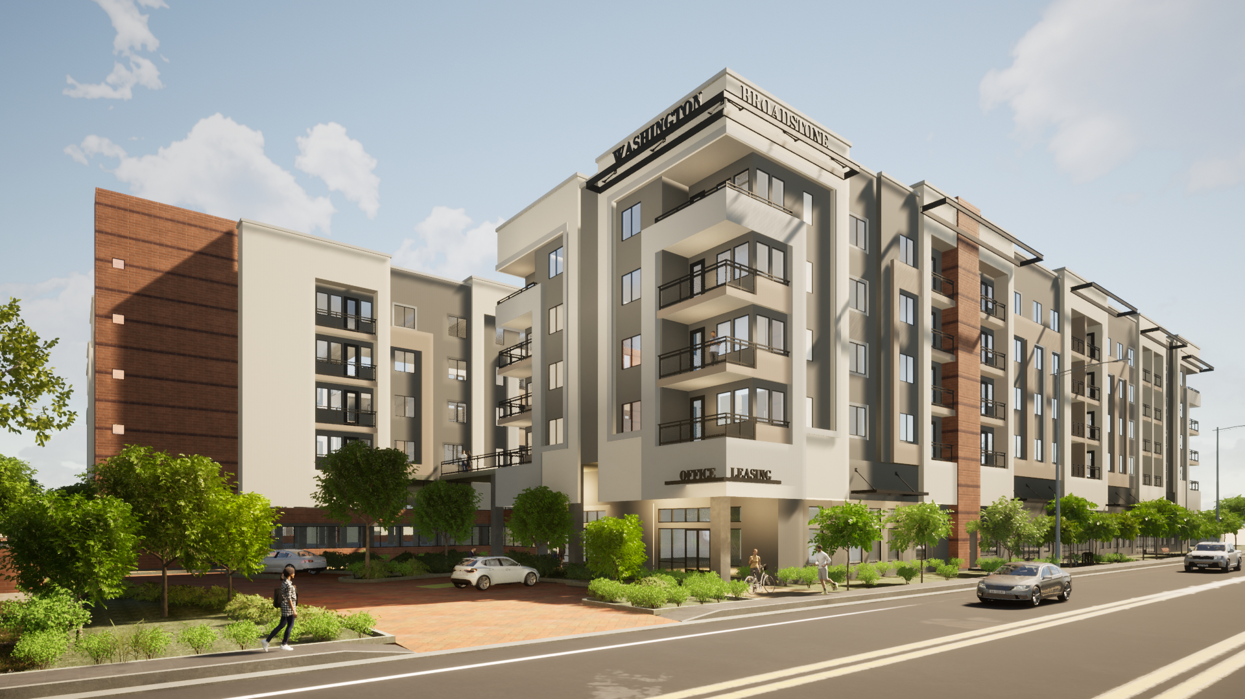
The Process
REVIT
REVIT
TWINMOTION
HIDDEN LINES
CONSISTENT COLORS

Slide 9
Verify what the rendering intent is.
Determine which elements of the project you want to highlight.
Verify initial picture framing with the designer this could be by hand sketching.
Understand who the intended audience will be for this stage of the project.

Slide 10
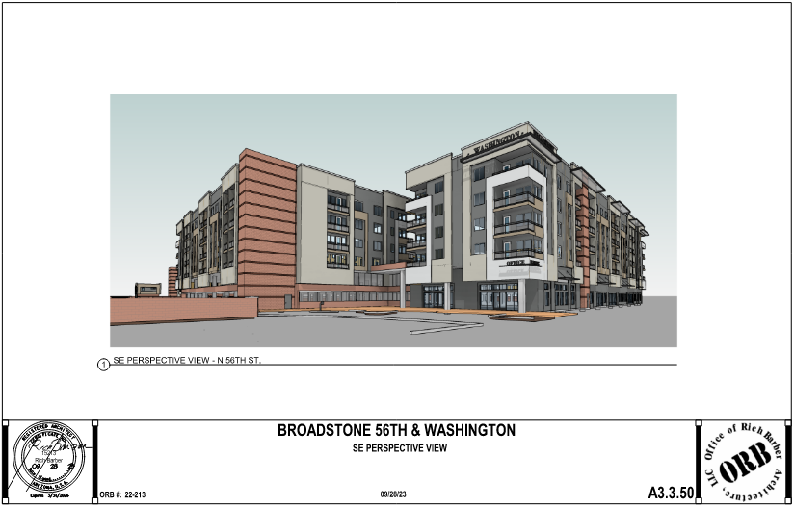
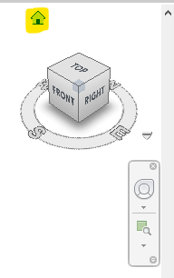
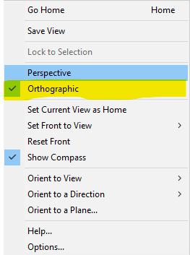
Initial renderings for client review can be achieved by a 3D View or a Camera View in Revit.
Use the following setups:
Create a new 3D view.
Change from orthographic to perspective

Slide 11
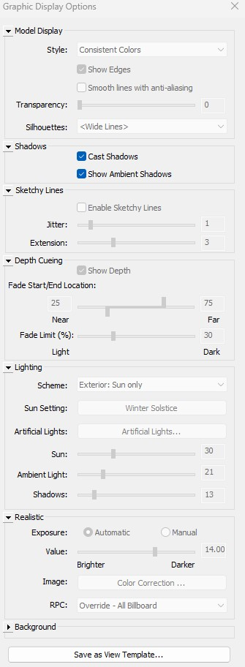
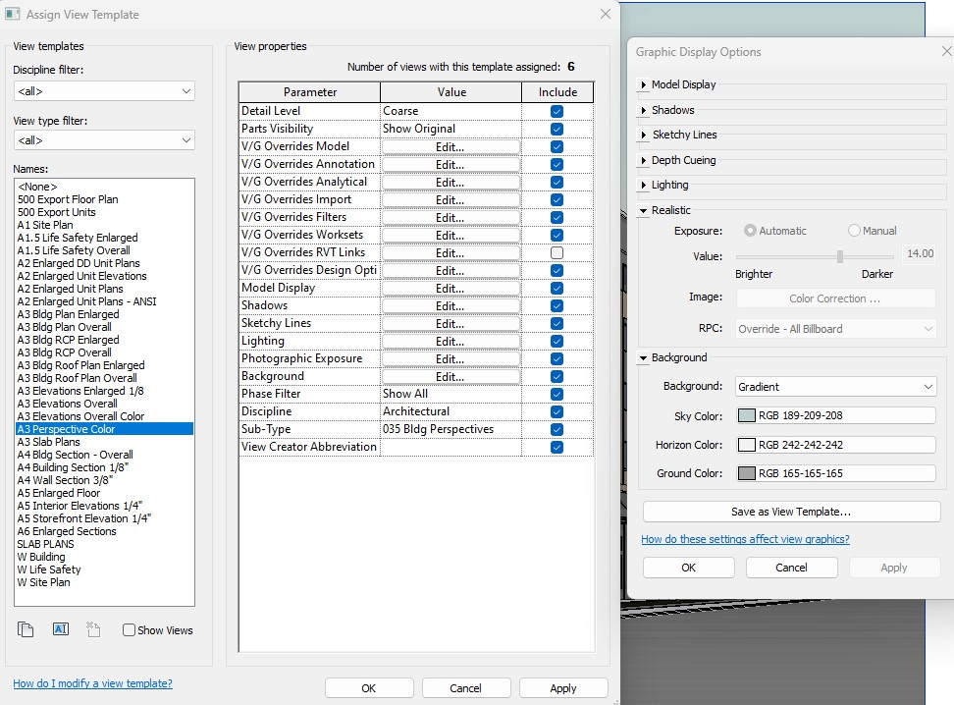
Setup the camara at 5’ ht. for pedestrian view.
2. Create a new template:
Turn off grid lines
Change background to gradient
Turn on shadows
Keep consistent colors
3. Rendering settings

Slide 12
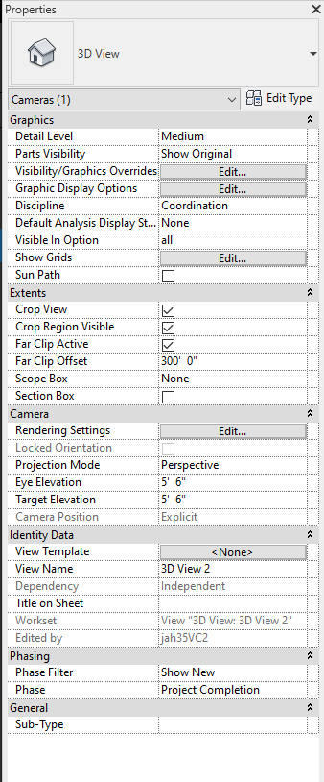
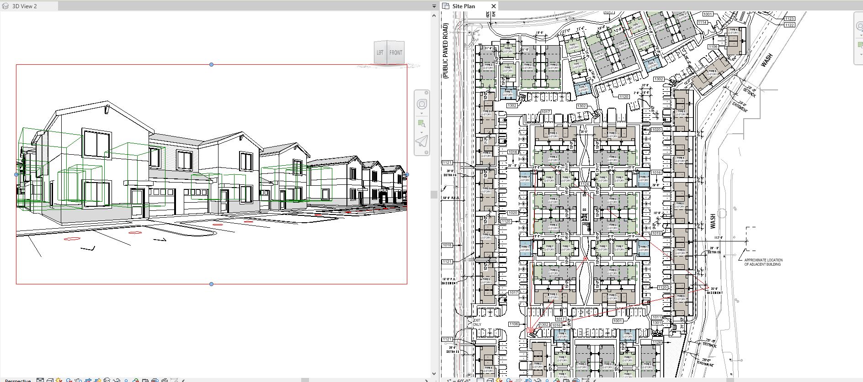
Camera view:

Slide 13
Insert a Project Title block based on the intent, and don’t forget to add the basics:
Date and Stamp
Project Name
Project Number
View location
Optional: add keymap to show the current picture location on site.

Slide 14
FINAL RENDER

Slide 15
SOFTWARE REQUIRMENTS AND INSTALL PROCESS – Twinmotion and Datasmith

Slide 16
INSTALLATION PROCESS
1
1- Open Revit and go to the View Tab. Click on Open in Twinmotion. If is installed Twinmotion will popout. If is the first time clicking, follow next steps:

Slide 17
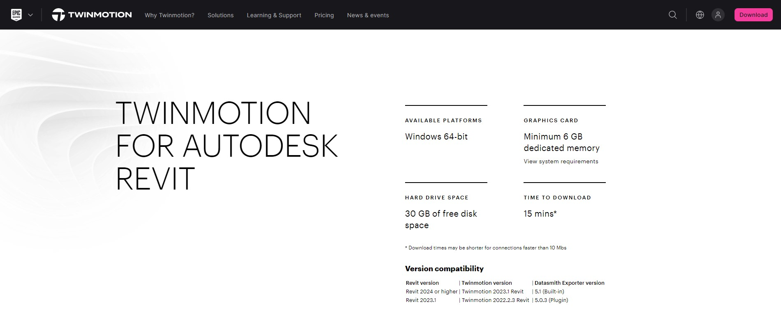
2
2- Verify the Revit version that you are using and check version compatibility.

Slide 18
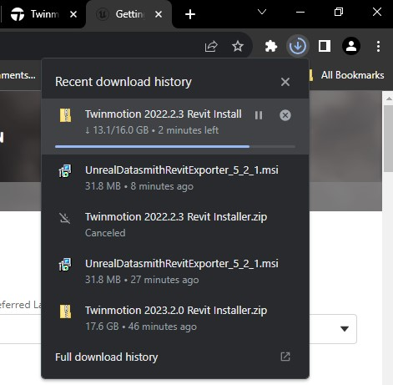
2- Installer file will start downloading automatically:
3- After the download is completed, you will see a compressed folder with the following name:
3

Slide 19
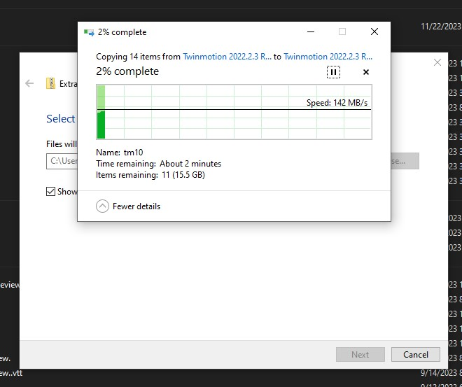
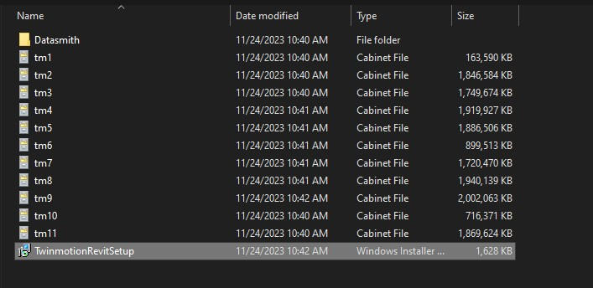
5- Double click the following file.
4
4- Right click and Extract All.
5

Slide 20
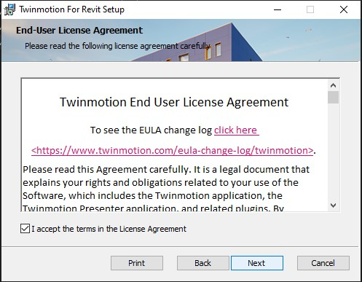
6
7

Slide 21
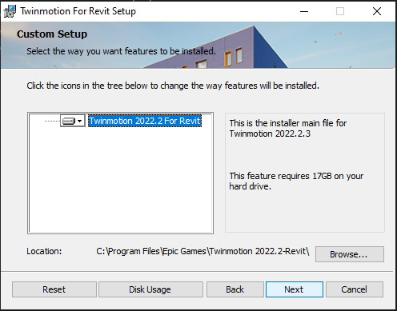
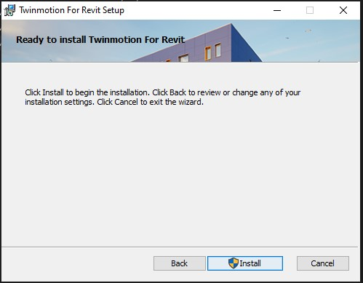
8
9
Note:
Make sure you will still have enough space in your hard disc drive after installing Twinmotion.

Slide 22
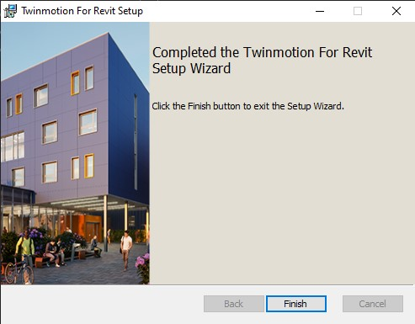
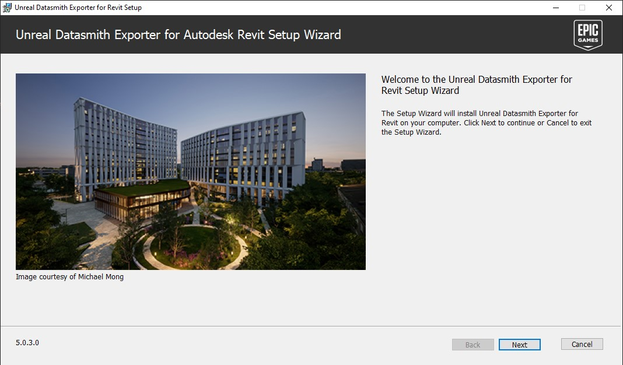
10
11

Slide 23
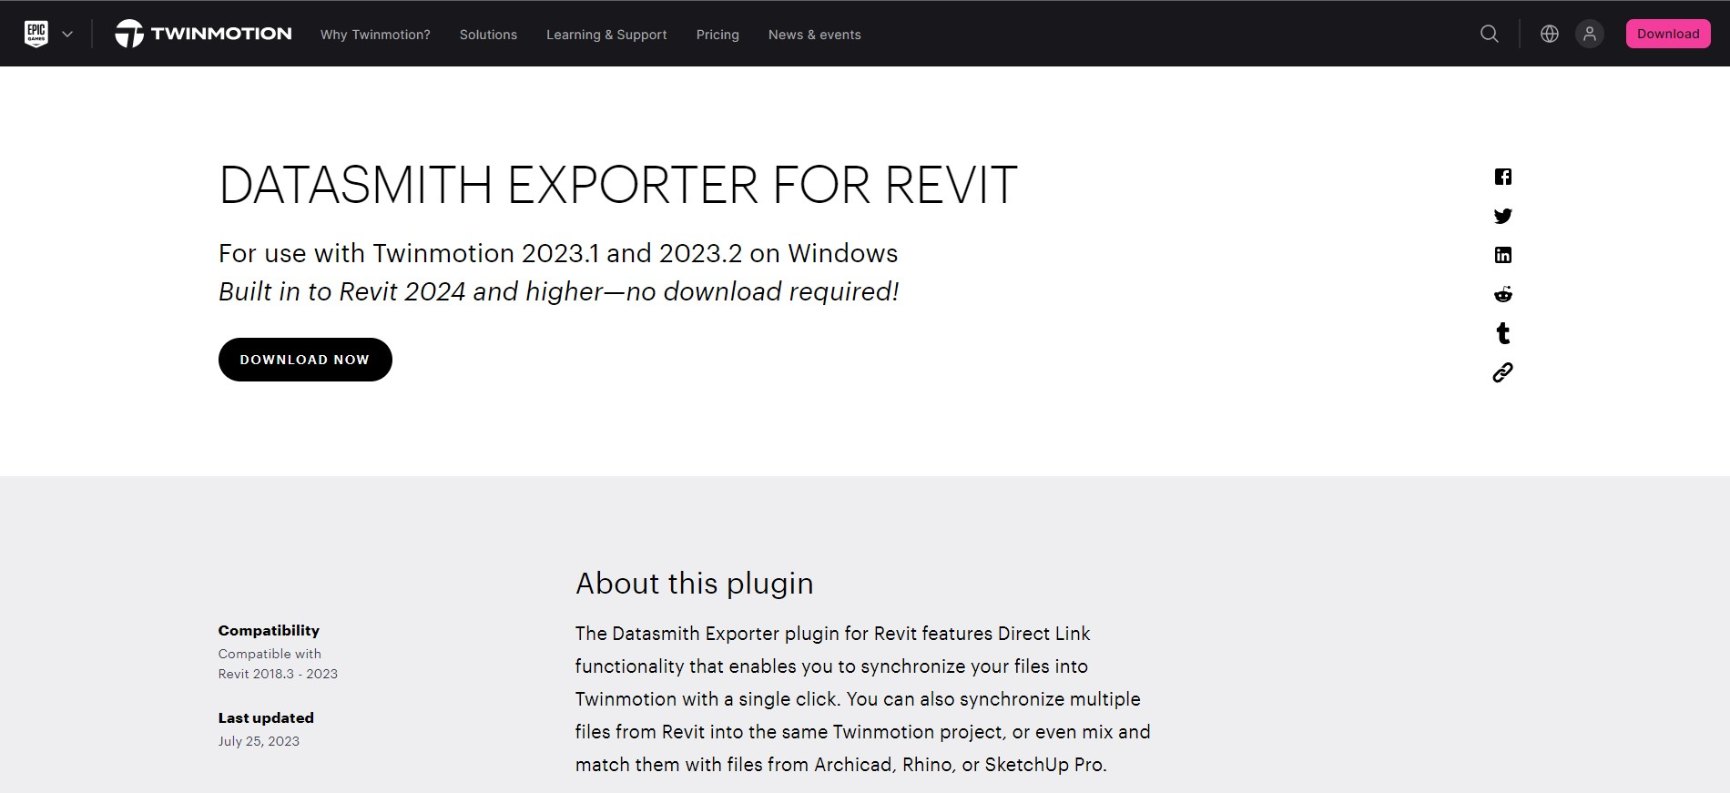
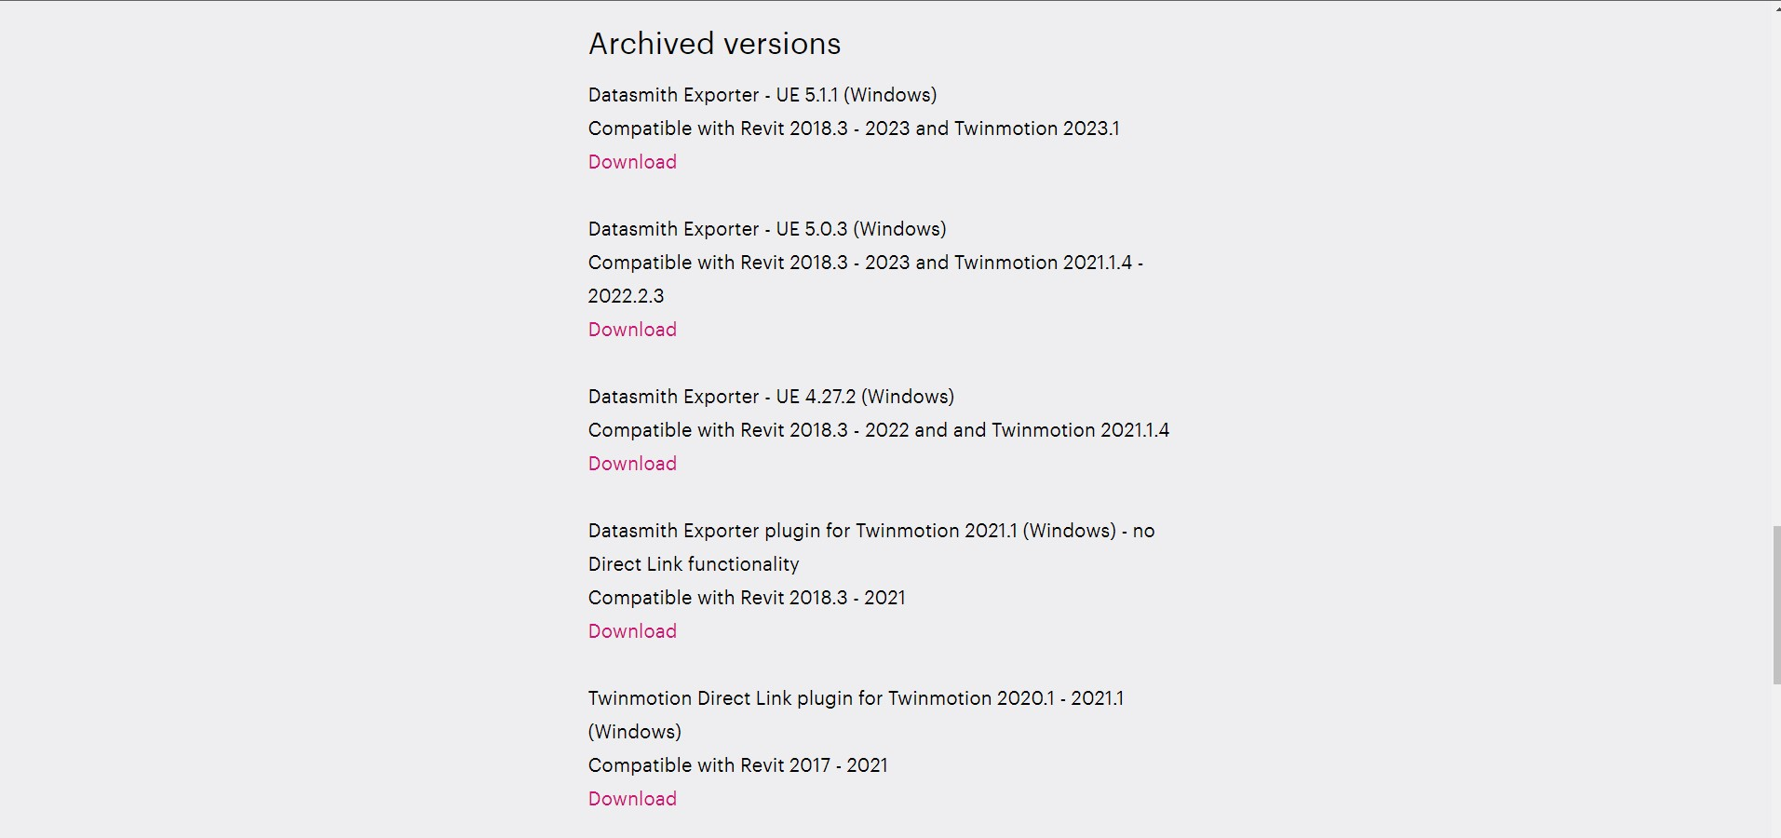
In case Datasmith does not open automatically.
In case the case that Datasmith does not run right after the Twinmotion installation, Google “Datasmith Exporter 5.0.3”

Slide 24
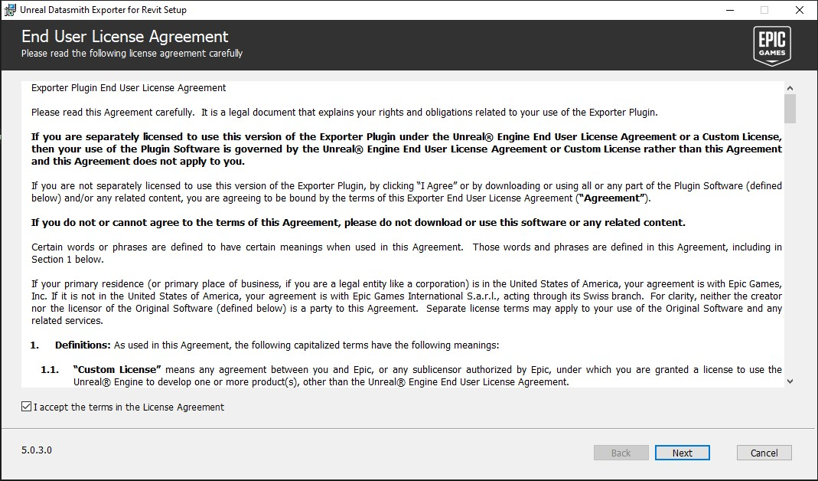
12

Slide 25
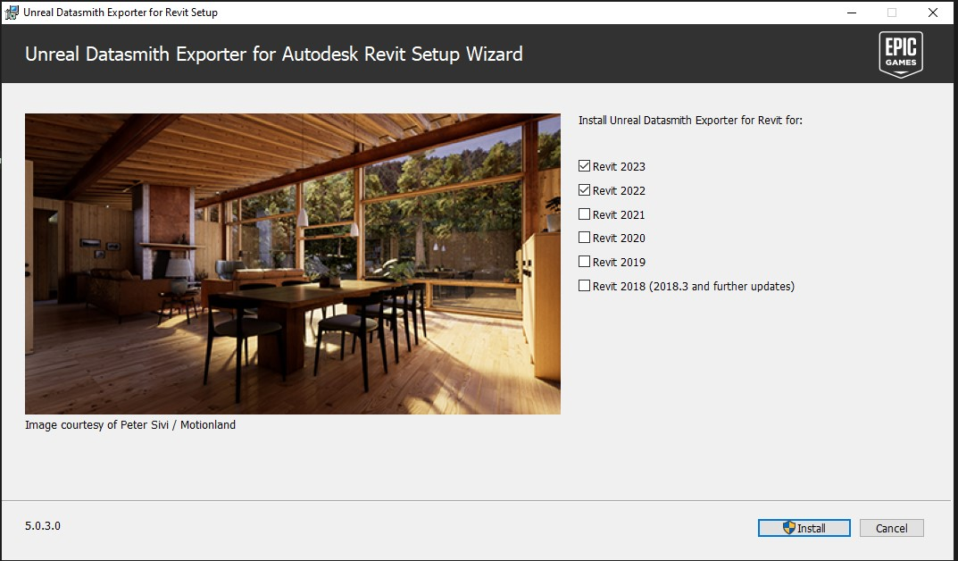
13

Slide 26
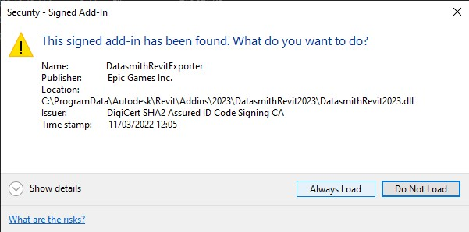
After installing Datasmith, open Revit and a message like this should appear.
Please “Always Load” this will allow the plugin to run automatically.
14
15
A Datasmith panel should appear in the ribbon menu.
By now, the installation process is completed.

Slide 27
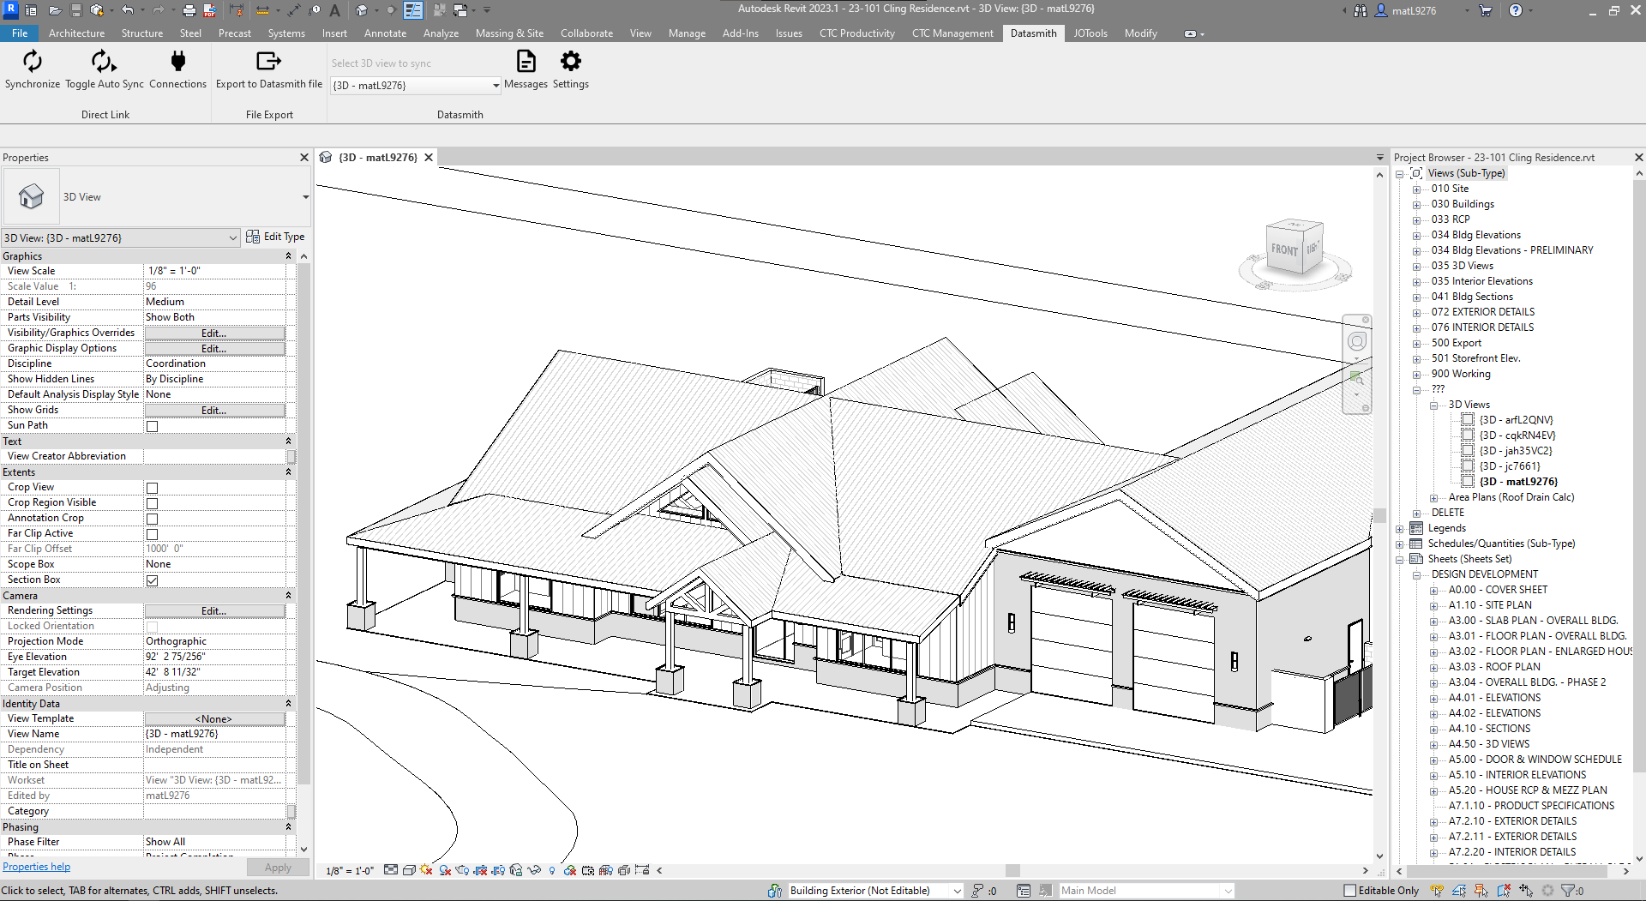
REVIT SETTINGS FOR RENDERING PROCESS
Now, with everything installed, when you click the Datasmith ribbon button, a menu like this appears:

Slide 28
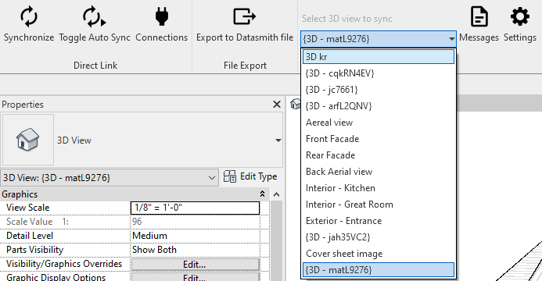
3
1
For better handling of the 3D model inside Twinmotion, please hide anything that will not be seen in the final rendering, like interiors, cabinets, furniture, etc.
2
In the drop-down menu we can choose which 3D view to sync with Twinmotion, it’ll sync whatever you see in the chosen view except for:
Hidden stuff
Model lines
Now please click the “Synchronize” button to link the Revit model to Twinmotion.

Slide 29
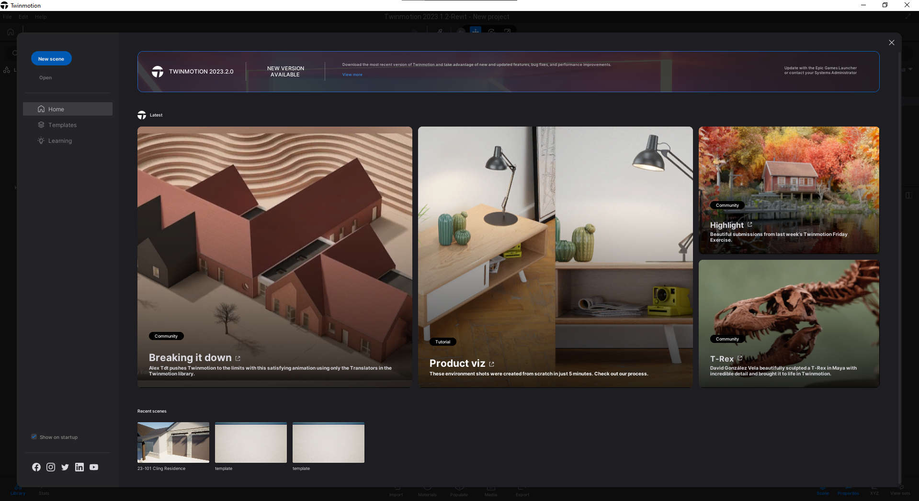
4
With Twinmotion opened, we should see the Home Panel.
Click on the “New scene” button start a new project where we’re going to import the Revit file.

Slide 30
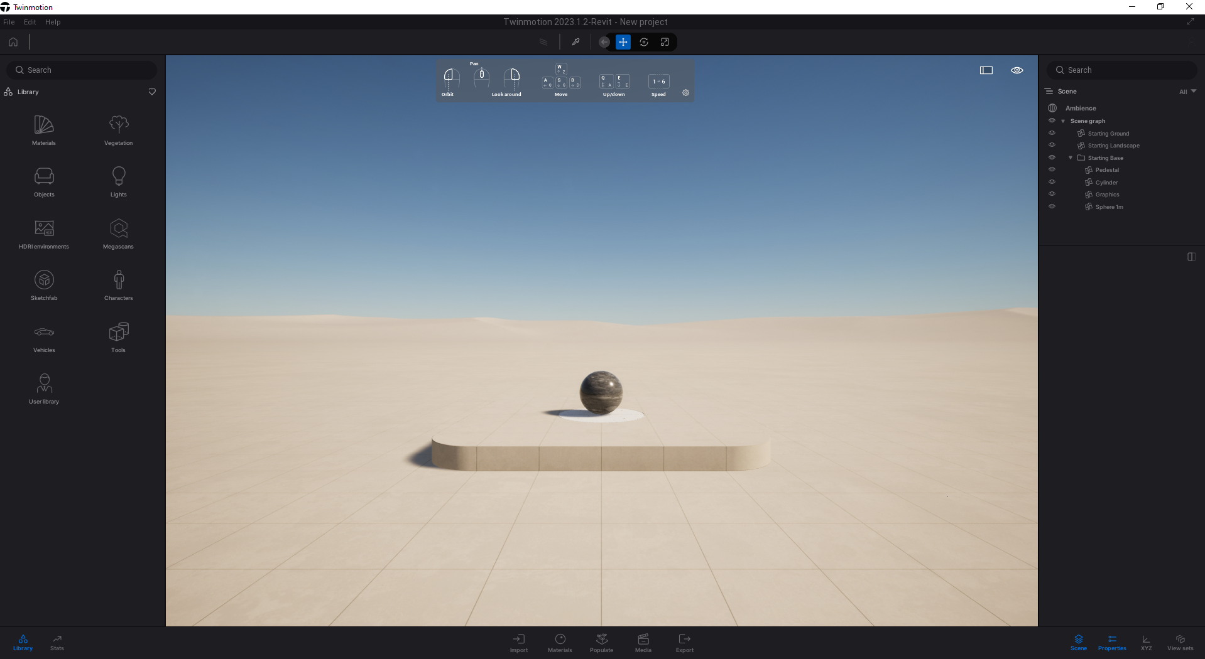
NAVIGATION PANEL
ASSET MANAGER
PROJECT EXPLORER
MODEL SPACE
EDITOR PANEL

Slide 31
5
In the editor panel click on the Import button to show the import menu.

Slide 32
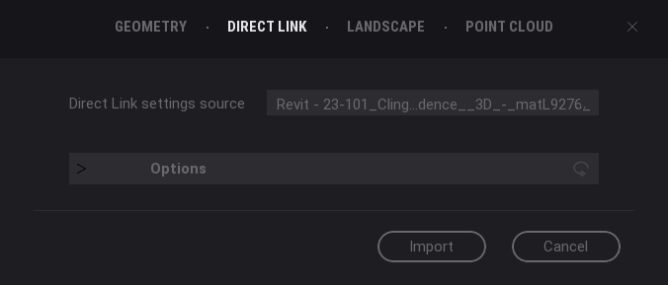
In the editor panel click on the Import button to show the import menu.
Then, click on the “+” button to import the Revit model.
6
7
Click in “Direct Link”, since we synchronized in Revit from the Datasmith menu, the name of the model and its view are selected by default.
There’re options for importing, but we’re going to leave the default ones.
Just click on Import to finalize the task.

Slide 33
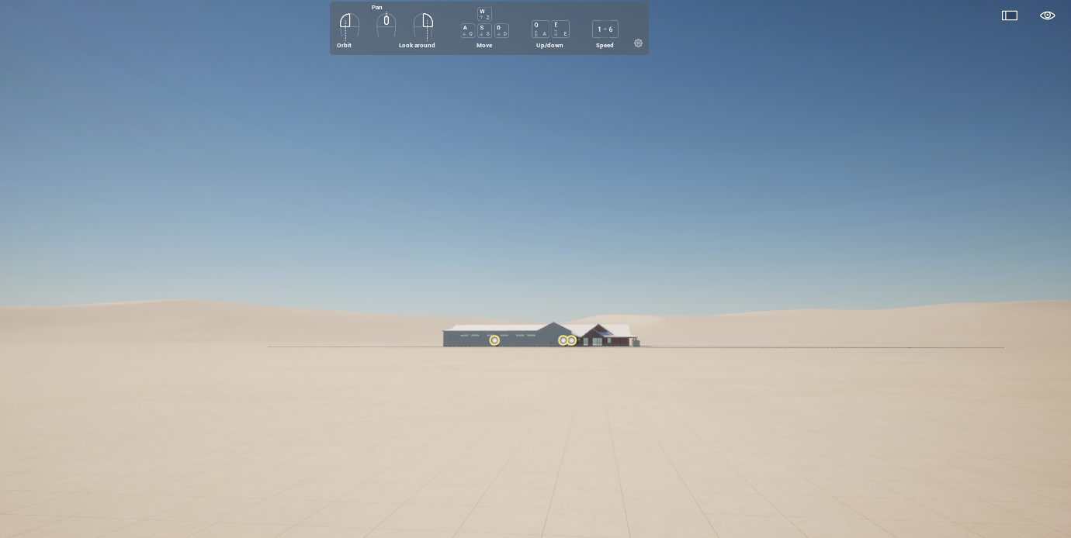
Depending on how heavy and/or big your model is, it may take a few moments to load completely, just be patient, and cheer your computer.
Once the import its finished, you may be going to see the same thing inside Twinmotion, just right click in the model space to look around your model.
And that’s it!
You’ve successfully imported your Revit model.

